Slide 1


PRINCIPLE OF FLIGHTS
Cdt CPL HARIHARAN B P

Slide 2
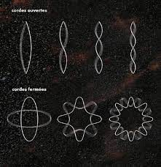
(PF-1) ELEMENTRY MECHANICS
Essential to have basic knowledge of “ELEMENTARY MECHANICS”.
Aircraft and the atmosphere in which it files are Matters and all matter are subjected to the laws of mechanics.
Everything around us is made up of matter.

Slide 3
FUNDAMENTAL CONCEPT
What we will be learning in the name of “ELEMENTARY MECHANICS”?
a) Mass b) Density c) Speed d) Velocity
e) Acceleration f) Newton’s First Law g) Momentum h) Force
i) Pressure j) Newton’s Second Law k) Newton’s Third Law l) Weight
m) Work n) Power o) Energy p) Law of Conservation
of energy
q) Momentum of Force r) Couple s) Equilibrium t) Centre of Gravity(CG)
u) Kinetic Energy

Slide 4
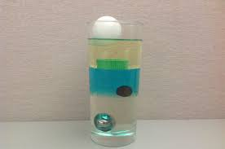
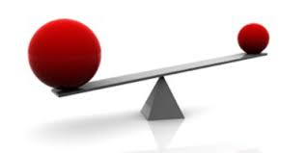
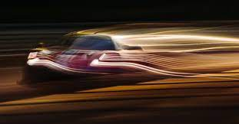
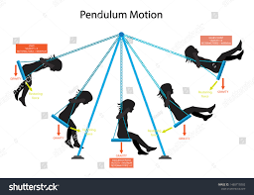
(PF-2) LAWS OF MOTION
1) Mass. Unit - Kilogram (kg) - ‘The quantity of matter in a body.’ The mass of a body is a measure of how difficult it is to start or stop, (“a body”, in this context, means a substance. Any substance a gas, a liquid or a solid).
2) Density. It is the mass per unit volume.
3) Motion. A motion is said to be there when a body changes its position in relation to its surroundings.
4) Speed. Speed is the rate of change of position.
5) Velocity. Velocity is speed in particular direction. Velocity is a vector quantity having both magnitude and direction.

Slide 5
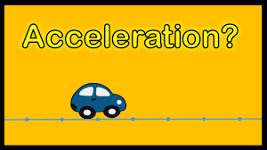
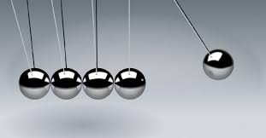
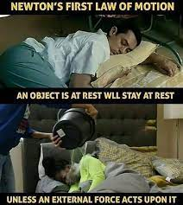
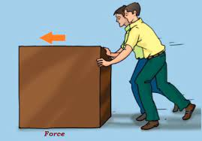
(PF-2) LAWS OF MOTION (Conti.)
6) Acceleration. Acceleration is the rate of change of velocity.
7) Newton’s First Law of Motion. A body will continue to be in state of rest or of uniform motion in a straight line unless acted upon by an external force.
8) Momentum. Unit - Mass x Velocity (kg-m/s) - ‘The quantity of motion possessed by a body’. The tendency of a body to continue in motion after being placed in motion.
9) Force. Unit - Newton (N) -‘A push or a pull’. That which causes or tends to cause a change in motion of a body.

Slide 6
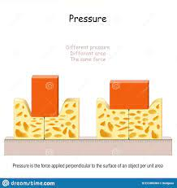
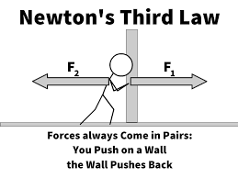
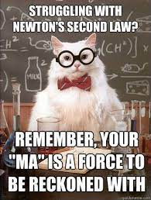
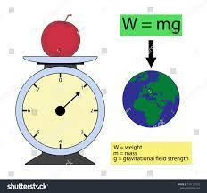
(PF-2) LAWS OF MOTION (Conti.)
10) Pressure. Pressure is force per unit area.
11) Newton’s Second Law of Motion. The rate of change of momentum of a body is directly proportional to the applied force and takes place in the direction of the application of the said force.
12) Newton’s Third Law of Motion. To every action, there is an equal and opposite reaction.
13) Weight. The force due to gravity is called weight.
(F = m x g)
14) Work. Unit - Joule (J) - A force is said to do work on a body when it moves the body in the direction in which the force is acting. (Work = Force x Distance)
15) Power. Unit - Watt (W) - Power is simply the rate of doing work, (the time taken to do work)

Slide 7
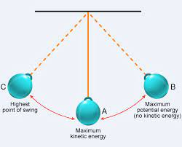
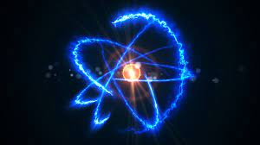

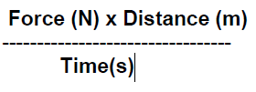
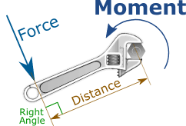
(PF-2) LAWS OF MOTION (Conti.)
15) Power. Unit - Watt (W) - Power is simply the rate of doing work, (the time taken to do work).
16) Energy. Unit - Joule (J) - Mass has energy if it has the ability to do work. The amount of energy a body possesses is measured by the amount of work it can do. The unit of energy will therefore be the same as those of work, joules.
17) Law of Conversation of Energy. The sum total of all energy in the universe remains constant.
18) Momentum of a Force. Moment of a force is the turning effect of the force about a point and is measured as the product of the force and the perpendicular distance between the point and the line of action of the force.

Slide 8
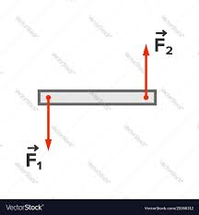
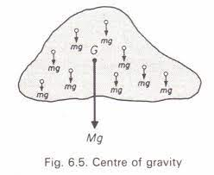
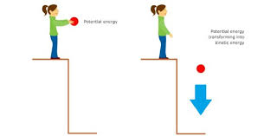
(PF-2) LAWS OF MOTION (Conti.)
19) Couple. A couple consists of two equal and opposite and parallel forces not acting through the same point.
20) Equilibrium. A body is said to be in equilibrium when:-
(a) Algebraic sum of all the forces acting on the body is zero.
(b) Clockwise moment is equal to the anti-clock wise moment about any point.
21) Centre of Gravity (CG). The point through which the weight of an aircraft acts.
(a) An aircraft in flight is said to rotate around its CG.
(b) The CG of an aircraft must remain within certain forward and aft limits, for reasons of both stability and control.
22) Kinetic Energy. Unit - Joule (J) - ‘The energy possessed by mass because of its motion’.

Slide 9
(PF-3) GLOSSARY OF TERMS
The following concepts will be taught under this concept:-
(a) Aerofoil (b) Chord line (c) Chord length (d) Angle of Attack
(e) Angle of Incidence (f) Total Reaction (g) Lift (h) Drag

Slide 10
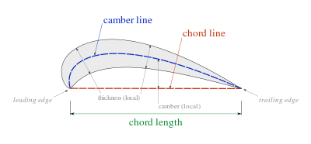
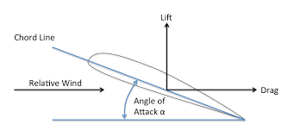
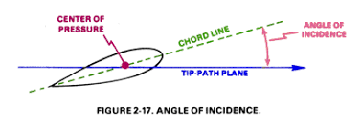
(PF-3) GLOSSARY OF TERMS (Conti.)
1) Aerofoil:- A body designed to produce more lift than drag.
2) Chord Line:- Line joining the centre of curvature of leading and trailing edge of an aerofoil section.
3) Chord Length:- The length of the chord line intercepted between leading and trailing edge is called chord length.
4) Angle of Attack:- The angle b/w chord line and relative air flow.
5) Angle of Incidence:- The angle b/w chord line and longitudinal axis of aircraft.
6) Total Reaction:- One single representing all the pressures over the surface of aerofoil.
7) Lift:- Vertical component of total reaction.
8) Drag:- Horizontal component of total reaction.

Slide 11
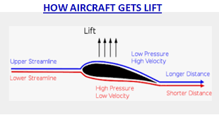
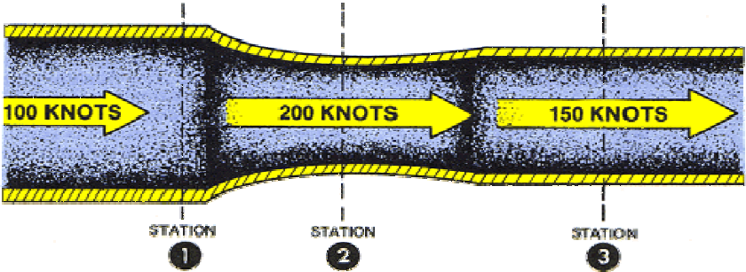
(PF-4) BERNOULLI’S PRINCIPLE & VENTURI EFFECT
Bernoulli's principle:- It states that for an inviscid flow, an increase in the speed of the fluid occurs simultaneously with a decrease in pressure or a decrease in fluid’s potential energy.
Bernoulli's principle helps explain that an aircraft can achieve lift because of the shape of its wings. They are shaped so that that air flows faster over the top of the wing and slower underneath. ... The high air pressure underneath the wings will therefore push the aircraft up through the lower air pressure.
Venturi Effect:- Between any two points in the tube the velocity varies inversely with the cross-sectional area. This phenomena is called as Venturi Effect.

Slide 12
(PF-5) AEROFOIL
Aerofoil is the shape of the wing or blade or sail that’s seen in cross-section.
This shape when moved through air produces an aerodynamic force.
The perpendicular component of this force to the direction of motion is called as lift.
With increased angle of attack, lift increases in a roughly linear relation, called slope of the lift curve.

Slide 13
TYPES OF AEROFOIL
1) Asymmetric airfoil can generate lift at zero angle of attack.
2) Symmetric a

